Slide 1

Analyzing Text Documents with Google Gemini
Unlock the power of Gemini for advanced text analysis, summarization, and intelligent Q&A.

Slide 2
Understanding Google Gemini
Generative AI
Extensive Context
Broad Access
Google's advanced AI assistant with multimodal capabilities.
Processes up to 1 million tokens, equivalent to ~1,500 pages.
Available via web app and integrated into Workspace Labs.

Slide 3

Core Text Analysis Features
Seamless Document Uploads
Instantly analyze PDFs, TXT, and DOCX files.
Enhanced Writing
Detect sentiment, improve grammar, style, and readability.
Content Enrichment
Access word definitions, thesaurus, and creative writing prompts.

Slide 4
Intelligent Document Summarization
Comprehensive Scope
In-Line Summaries
Summarizes entire documents, even across multiple tabs or sections.
Generate concise summaries directly within Google Docs using @Summary.
Early Access
Dynamic & Editable
Currently available through the exclusive Google Workspace Labs program.
Summaries are fully editable and refreshable for continuous accuracy.

Slide 5



Advanced Question Answering
Contextual Queries
Multi-Step Reasoning
Code Assistance
Ask detailed questions about any uploaded text or code content.
Gemini Advanced handles complex topics and research papers.
Provides explanations, debugging, and optimization for codebases.

Slide 6



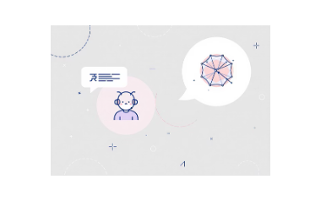
Versatile Integration Examples
Text Analyzer AI app: Gemini enhances writing assistance.
BigQuery integration: Streamlined data analysis support.
Gemini Apps web platform: For brainstorming and content creation.
Multi-model AI chat: Supports Gemini alongside OpenAI and others.

Slide 7

Enhanced User Experience
Conversational AI
Natural interactions with Gemini Live for seamless engagement.
Global Reach
Supports 45+ languages in over 150 countries.
Contextual Responses
Upload files and images for real-time, relevant answers.
Personalized Interface
Features like dark mode, auto-archive, and customizable themes.

Slide 8




Access & Technical Requirements
Google Account
Browser Compatibility
Personal, work, or school account required for access.
Supports Chrome, Safari, Firefox, Opera, and Edgium.
Premium Features
Feedback Loop
Some advanced features require a Google One AI Premium subscription.
Built-in mechanisms for continuous AI safety and accuracy improvements.

Slide 9
Key Benefits for Users
⚡
✍️
💡
💬
Time Savings
Writing Enhancement
Deeper Understanding
Seamless Interaction
Automates document review and summarization tasks.
AI suggestions improve quality, clarity, and conciseness.
Facilitates comprehension of complex materials.
Supports multitasking with voice and chat capabilities.

Slide 10

Conclusion & Future Outlook
Gemini revolutionizes text document analysis and interaction.
Expanding AI capabilities for richer, dynamic content handling.
Continuous improvements via user feedback and research.
Potential for broader applications in education, business, and coding.

